Slide 1
UDP flood
Group Members:
Muhammad Ahsan Qadri (02-131222- )
Muhammad Shumail Tassadaq (02-131222- )
Abdullah (02-131222-099)

Slide 2
Before Moving to UDP Flood Attacks, we shall get to know in detail, what UDP is, and why it is vulnerable

Slide 3

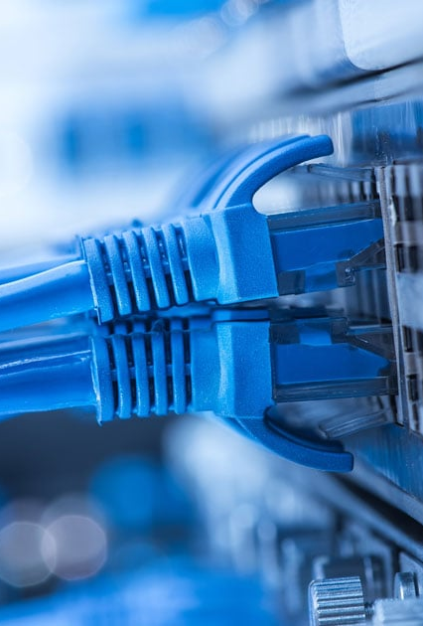
What is UDP?
The full form of UDP is User Database Protocol
It is a communication protocol used on the internet used to establish a loss-tolerating and delay-tolerating connection across the internet
UDP protocol is faster, efficient and more reliable than TCP(Transmission Control Protocol), but is more prone to errors than TCP/IP
Both UDP and TCP operate over IP and are referred to as UDP/IP or TCP/IP
This Photo by Unknown Author is licensed under CC BY-SA

Slide 4
More about UDP
UDP allows units of communication containing information(packets) to be received and dropped in different order than how they were transmitted, making UDP optimal for Real-Time communication.
UDP doesn’t require for opening, maintaining and closing a connection.
Some of the most common uses of UDP is gaming, video conferencing, real-time capital transaction, streaming videos etc.

Slide 5
Where udp is used?
Some of the most common uses of UDP is gaming, video conferencing, real-time capital transaction, streaming videos etc.
Popular Online games like Valorant, League of Legends, CS:GO, Call Of Duty: Warzone etc. use UDP for latency-free and stable connection.
Popular online conferencing apps like Zoom, WhatsApp audio/video calls, etc. use UDP for seamless communication.

Slide 6
Why is UDP preferred over TCP?
UDP allows the transfer of data to be initiated faster without delay or extended latency times.
TCP initiates many error-checking when communication is established, and this makes TCP slower than UDP. This occupies a lot of bandwidth. UDP doesn’t check so often for errors, hence occupying less bandwidth. This makes UDP faster than TCP
UDP can be used for media streaming, and simultaneously communicating with 2 or more endpoints.

Slide 7
Why is UDP vulnerable?
UDP lacks verification methods which makes it prone to errors and attacks
The absence of an initial handshake and absence of built-in protection mechanisms make UDP very vulnerable to DoS attacks
UDP communication is most prone to UDP flood, DNS amplification and UDP port scan attacks. Today we will be looking at what UDP flood is in detail.

Slide 8
What is meant by UDP flood attacks?
UDP flood is a Denial-of-Service attack in which large number of data packets are sent to random ports on the targeted server in order to overload the server so that data-transfer is delayed or ultimately completely stopped.
Data transfer to legitimate traffic is partially or completely blocked.
This is easy as UDP doesn’t perform numerous scans to validate data, so a large amount of data packets send by the attacker can overwhelm the server, causing delay in the time the server takes to communicate.

Slide 9
How does a UDP flood attack work?
As mentioned in the previous slide, a UDP flood attack is caused when a server is overloaded with data packets, making the server slow and hindering its ability to communicate, but how does that work?
UDP flood primarily functions by exploiting the steps taken by the server. Under normal conditions a server receives a UDP packet, it goes through the following steps:
Server checks to see if any programs are running which are listening for that request.
If no programs are running that are ready to receive that packet, the server responds with a packet telling the sender that destination is unreachable

Slide 10
Overloading the server with data packets
When UDP packets are transmitted, the contain the IP address of the source device. When the attacker sends arbitrary data packets to overload the server, it uses a dummy IP Address, masking the attacker's true location, hence making it difficult for the attacker to be found.
The server utilizes more and more resources for the incoming packets. A time comes when the server runs out of resources to deal with the UDP packets and starts slowing down, resulting in Denial of Service for legitimate users.
The server sends an ICMP Packet to the user(s) requesting service, which indicates that the service cannot be reached.

Slide 11
UDP Floods as DNS Amplification
DNS Amplification is a DDoS(Distributed Denial of Service) attack where the attacker exploits flaws in the DNS of the server. The DNS will turns small queries into very large workloads which will overwhelm and bring down the victims server.
UDP Flood attacks as DNS Amplification are also known as “Alphabet Soup”.
Another one of UDPs vulnerabilities is that it does not specify the packet size, so the attack send very large packets (sometimes over 8KB in size) filled with random text and numbers (hence the name “Alphabet Soup”) in huge quantities to overwhelm the server.

Slide 12
What happens when the server receives the flood packets?
When the server receives these junk packets, which have no ports or programs listening for it, it replies with an ICMP packet.
An ICMP packet is sent by the destination to source which implies that the destination is unreachable or doesn’t exist.
The use of many machines to simultaneously send data packets to targeted server, whether amplified or non-amplified, will make this attack a DDoS attack.

Slide 13
So, What’s the solution?
UDP flooding can be quickly identified by noticing an increased spike in the volume of incoming traffic.
Any and all suspicious packets are rejected by the server. The firewall filter all the packets to ensure that no suspicious or junk packet enter the data stream. However, The firewall can also collapse under the sheer volume of the packets being sent by the attacker.
UDP Packets are filtered except for DNS requests. Any source generating massive amounts of UDP packets is seen as suspicious and are rejected.

Slide 14
The solution…
The best possible solution to mitigate UDP flood attacks is the use of specialized cloud services like Cloudflare. Cloudflare can distribute the network traffic across a large number of globally located Data centers. This creates enough bandwidth that even if an attacker floods the server with junk data, the server can withstand the load while it initiate ICMP Rate limiting

Slide 15


What is ICMP Rate limiting?
A device, on average, receives a lot of ICMP(Internet Control Message Protocol) packets. These packets consume a lot of CPU resources, hence limiting the rates of the ICMP packets can ensure smooth communications between server and client while retaining CPU resources.
This phenomenon is known as ICMP Rate Limiting.
Limiting ICMP responses greatly helps in dealing with UDP floods
This Photo by Unknown Author is licensed under CC BY-SA

Slide 16
Thank You.

